Slide 1
DESIGN PATTERNS

Slide 2
WHY DESIGN PATTERNS?
TEXT
Design patterns are recurring solutions to a design pattern
A pattern describes a proven solution to the recurring design problem
A design patterns are well-proved solution for solving the specific problem/task.

Slide 3
ADVANTAGES
TEXT
They are reusable in multiple projects.
They provide the solutions that help to define the system architecture.
They capture the software engineering experiences.
They provide transparency to the design of an application.
They are well-proved and testified solutions since they have been built upon the knowledge and experience of expert software developers.
Design patterns don?t guarantee an absolute solution to a problem. They provide clarity to the system architecture and the possibility of building a better system.

Slide 4
TYPES OF DESIGN PATTERNS
TEXT
Core java (or JSE) Design Patterns.
      Creational design patterns
        Defines best possible way of creating an object.
      Structural design patterns
        Describes how objects and classes can be combined to form large structure.
      Behavioural design patterns
        Interaction between objects.
JEE Design Patterns

Slide 5
CREATIONAL DESIGN PATTERNS
TEXT
1. Singleton Pattern
2. Factory Pattern
3. Abstract Factory Pattern
4. Prototype Pattern
5. Builder Pattern.

Slide 6
STRUCTURAL DESIGN PATTERN
TEXT
1. Adapter Pattern
2. Bridge Pattern
3. Composite Pattern
4. Decorator Pattern
5. Facade Pattern
6. Flyweight Pattern
7. Proxy Pattern

Slide 7
BEHAVIOURAL DESIGN PATTERN
TEXT
1. Chain Of Responsibility Pattern
2. Command Pattern
3. Interpreter Pattern
4. Iterator Pattern
5. Mediator Pattern
6. Memento Pattern
7. Observer Pattern
8. State Pattern
9. Strategy Pattern
10. Template Pattern
11. Visitor Pattern

Slide 8
J2EE DESIGN PATTERNS
TEXT
MVC
Business delegate
Composite entity
Data access object
Front controller
Intercepting filters
Service locator
Transfer objects
Session Facade

Slide 9
SINGLETON DESIGN PATTERN
TEXT
define a class that has only one instance and provides a global point of access to it.
a class must ensure that only single instance should be created and single object can be used by all other classes.
Saves memory because object is not created at each request. Only single instance is reused again and again.
Singleton pattern is mostly used in multi-threaded and database applications. It is used in logging, caching, thread pools, configuration settings etc.
If singleton class is loaded by two classloaders, two instance of singleton class will be created, one for each classloader.

Slide 10
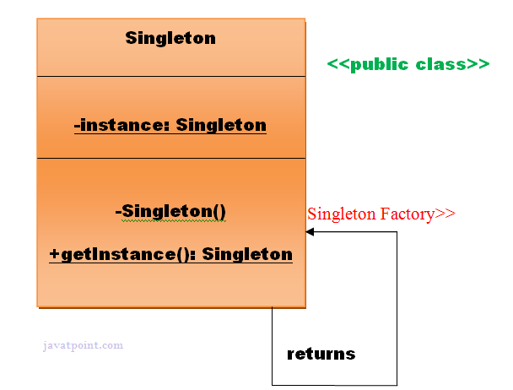
TEXT

Slide 11
HOW TO CREATE SINGLETON DESIGN PATTERN
TEXT
To create the singleton class, we need to have static member of class, private constructor and static factory method.
    Static member: It gets memory only once because of static, it contains the instance of the Singleton class.
    Private constructor: It will prevent to instantiate the Singleton class from outside the class.
    Static factory method: This provides the global point of access to the Singleton object and returns the instance to the caller.

Slide 12
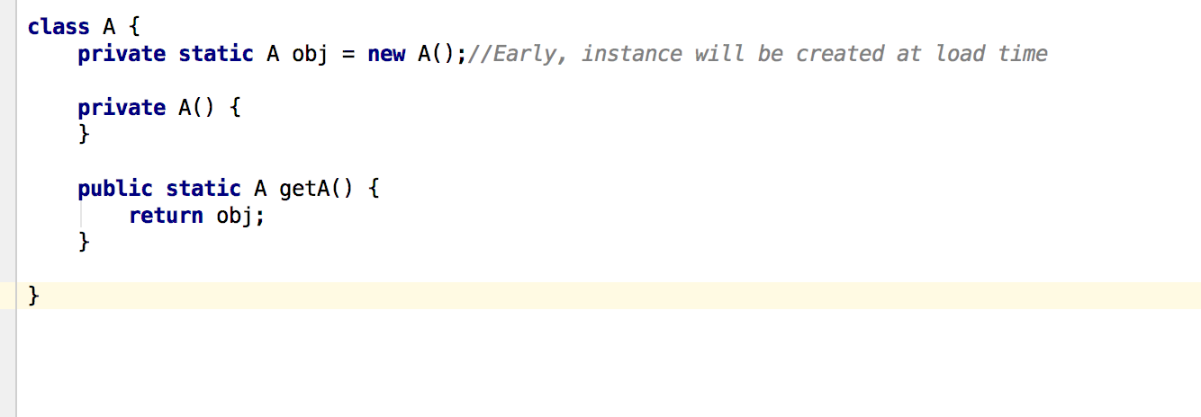
TEXT

Slide 13
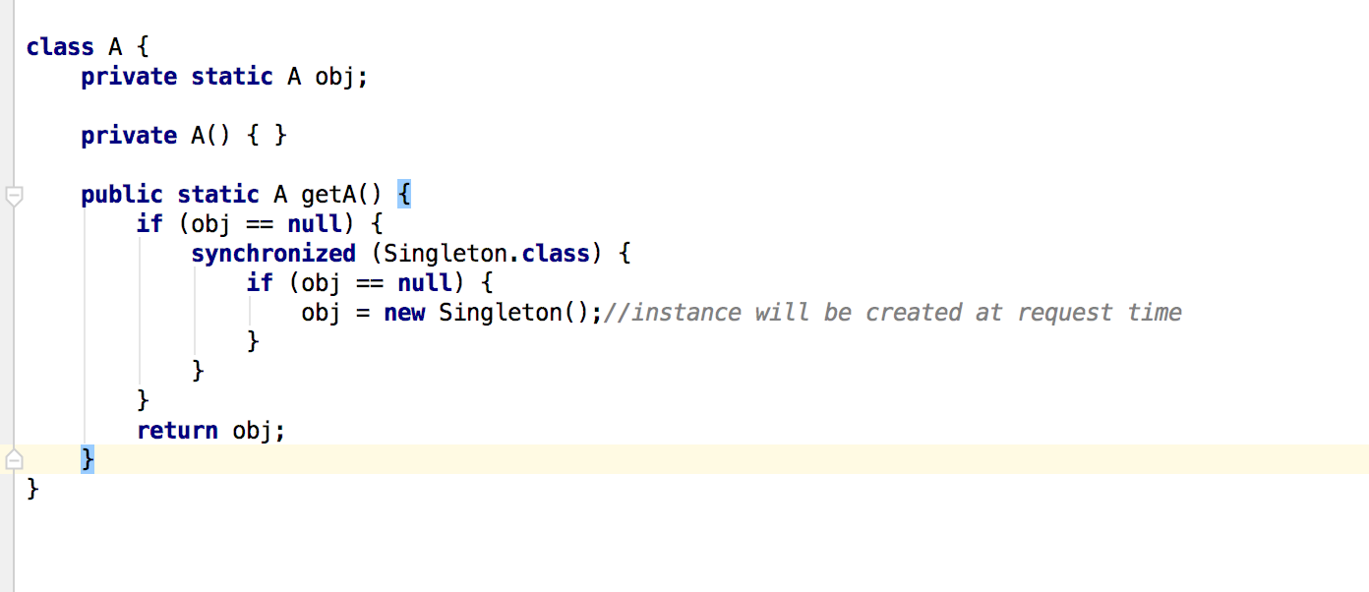
TEXT

Slide 14
FACTORY PATTERN
TEXT
the factory method pattern is a creational pattern that uses factory methods to deal with the problem of creating objects without having to specify the exact class of the object that will be created.
define an interface or abstract class for creating an object but let the subclasses decide which class to instantiate OR
subclasses are responsible to create the instance of the class.

Slide 15
ADVANTAGES
TEXT
Factory Method Pattern allows the sub-classes to choose the type of objects to create.
It promotes the loose-coupling by eliminating the need to bind application-specific classes into the code. That means the code interacts solely with the resultant interface or abstract class, so that it will work with any classes that implement that interface or that extends that abstract class.

Slide 16
WHEN TO USE IT?
TEXT
When a class doesn't know what sub-classes will be required to create
When a class wants that its sub-classes specify the objects to be created.
When the parent classes choose the creation of objects to its sub-classes.

Slide 17
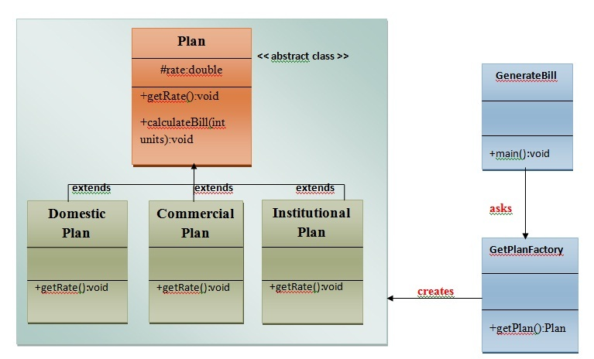
TEXT

Slide 18
PROTOTYPE DESIGN PATTERN
TEXT
cloning of an existing object instead of creating new one and can also be customized as per the requirement.
Advantages
  It reduces the need of sub-classing.
  It hides complexities of creating objects.
  The clients can get new objects without knowing which type of object it will be.
  It lets you add or remove objects at runtime.

Slide 19
BUILDER PATTERN
TEXT
construct a complex object from simple objects using step-by-step approach
Advantages
    It provides clear separation between the construction and representation of an object.
    It provides better control over construction process.
    It supports to change the internal representation of objects.

Slide 20
STRUCTURAL PATTERNS
TEXT

Slide 21
ADAPTER PATTERN
TEXT
converts the interface of a class into another interface that a client wants
Advantages:
  It allows two or more previously incompatible objects to interact.
  It allows reusability of existing functionality.

Slide 22
BRIDGE PATTERN
TEXT
decouple the functional abstraction from the implementation so that the two can vary independently.

Slide 23
REFERENCE
TEXT
https://www.tutorialspoint.com/design_pattern/index.htm
https://www.javatpoint.com/design-patterns-in-java

